Slide 1
The Game

Slide 2
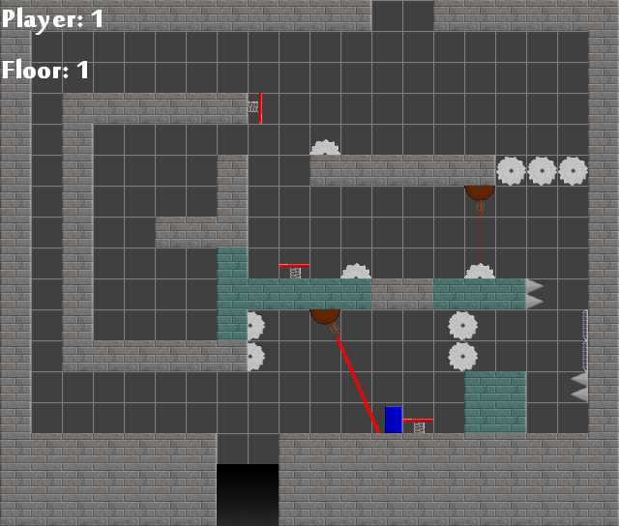
The Game
It sounded viable.
It was pretty fun to make.
Design meetings.

Slide 3
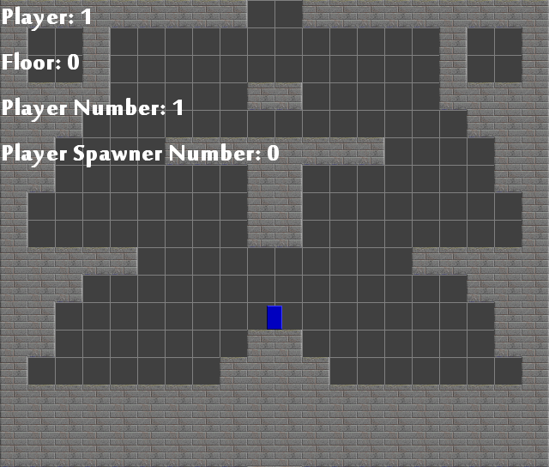
We Lost The Game
Not enough team members could help.
It took way too long.

Slide 4
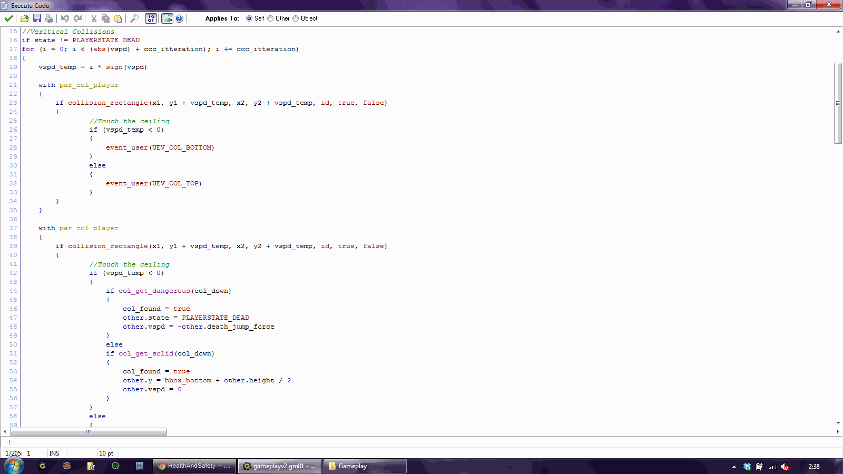
The Game
Spend too long in preparation.
Other modules got in the way.

Slide 5
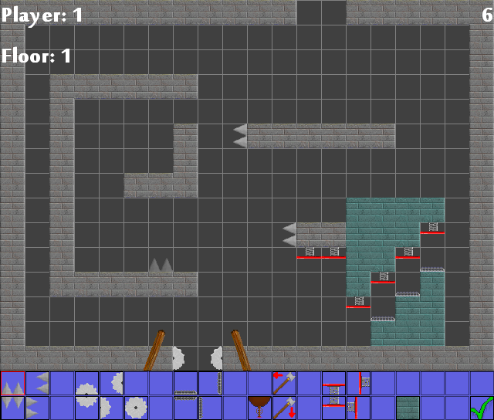
Next Time
Pick a smaller project.
Include the whole team for the whole project.

